Slide 1
MGB235 Monitoring and Managing Operational Performance
Week 1 : Unit Overview
Welcome to MGB235!
Dr Kavoos Mohannak
Unit coordinator/Lecturer

Slide 2
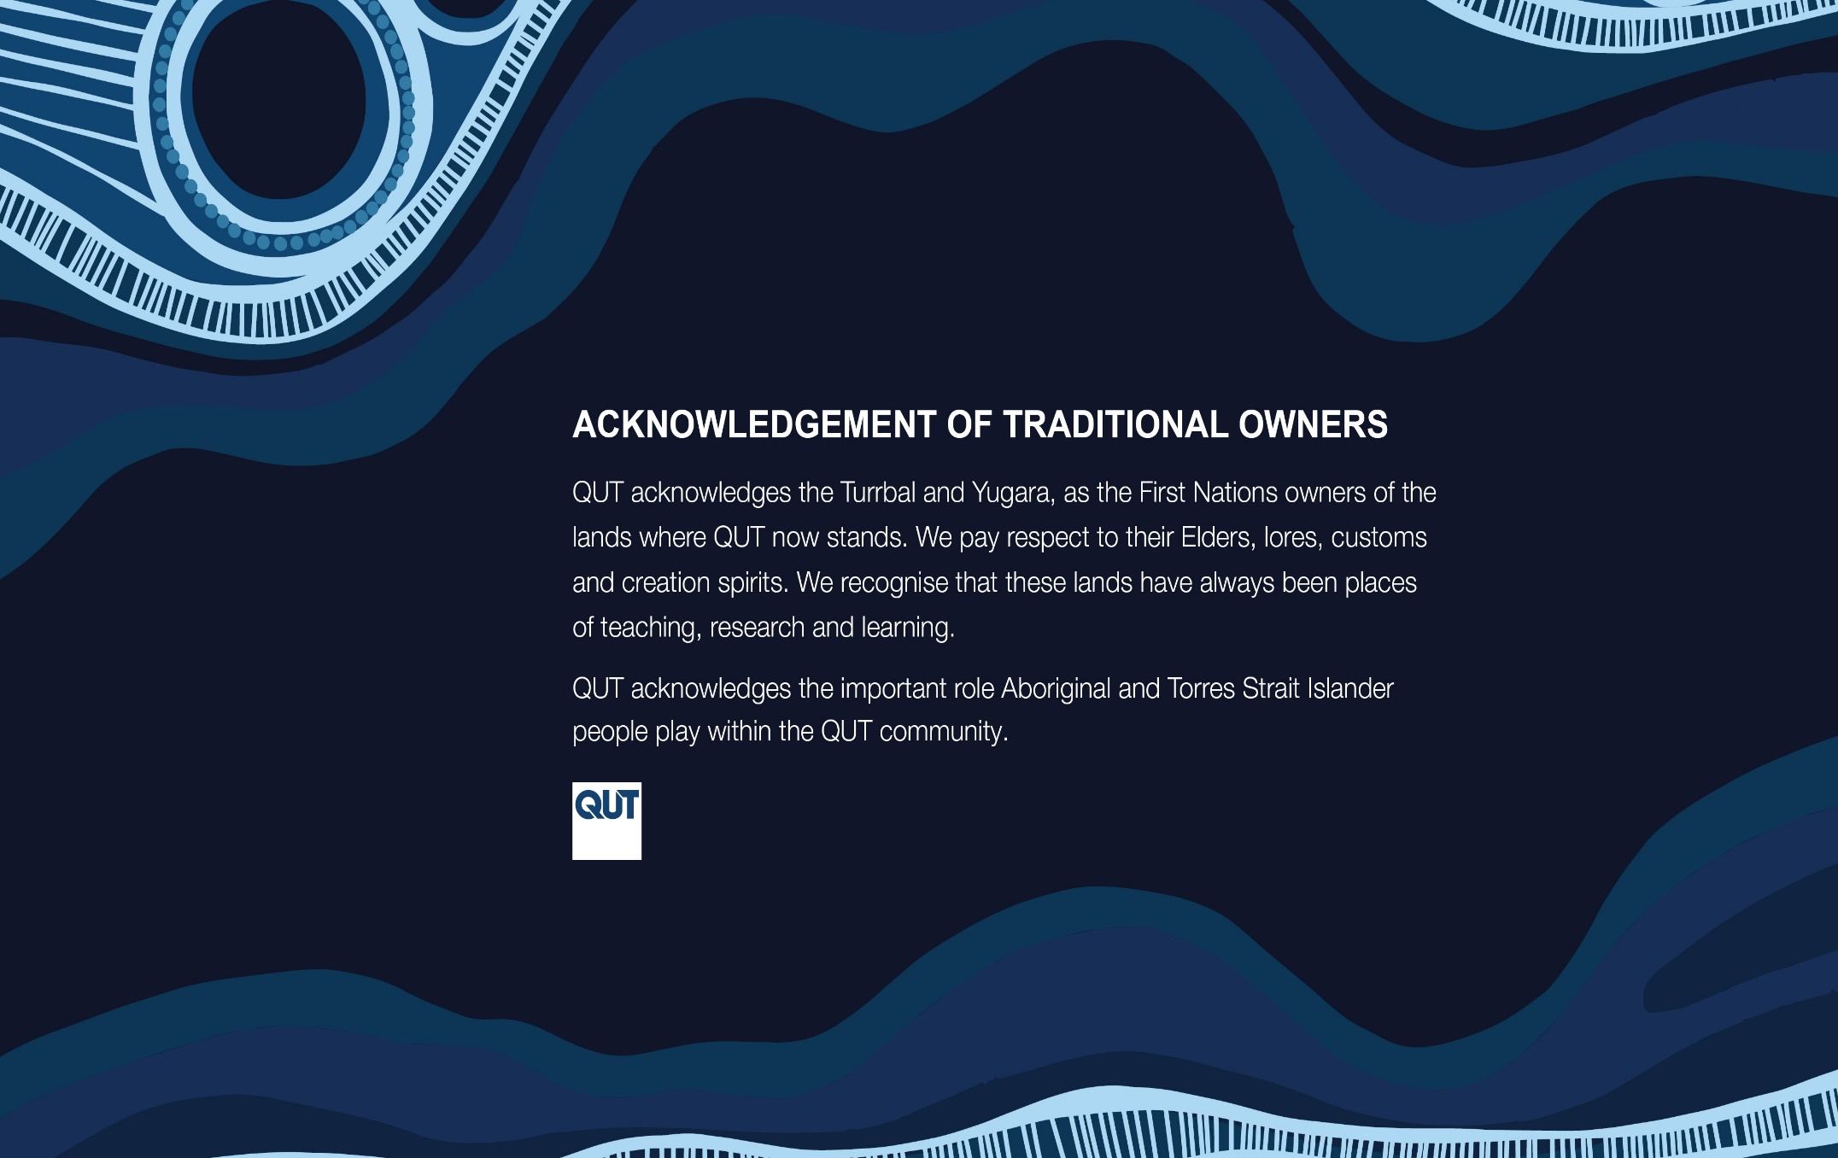

Slide 3
Teaching Staff
Dr Kavoos Mohannak (Unit Coordinator/Lecturer)
Room: Z909a; Phone: 3138 2508
Email: k.mohannak@qut.edu.au
Consultation hours: By appointment
Tutorials on Tuesdays:
Mr. Peter McCulloch (p1.mcculloch@qut.edu.au): Face-to-face tutorials on Tuesdays at 12:00 am (Room Z-306), 1:00 pm (Room Z-504) and 5:00 pm (Room Z-207)
Dr Dusan Bojic (d2.bojic@qut.edu.au): Face-to-face tutorials on Tuesdays at 10:00 am (Room S-306) and 1:00 pm (Room Z-606)
Ms. Jessica Barjaktarovic (jessica.barjaktarovic@qut.edu.au) Online tutorials (5:00 – 6:00 pm & 6:00 – 7:00 pm)
Please note for inquiry regarding class registration contact:
askqut@qut.edu.au
buslaw.enquiries@qut.edu.au

Slide 4
LECTURE 1 – OUTLINE
Why study this unit? Unit Outcome?
Semester program and assessments
Define the key terms and identify similarities and differences between production and service operations
Explain the importance of learning about operations management
Identify major functional areas of organizations and explain how they interrelate
Summarize the two major aspects of process management
Describe the operations function and the nature of the operations manager’s job
Explain the key aspects of operations management decision making
Briefly describe the historical evolution of operations management
Describe the current issues in business that impact operations management
Explain the need to manage the supply chain

Slide 5
Why study MGB235?
Examines the processes used in producing goods or services of the organisation.
Providing you with "manager's toolkit" for identifying, monitoring and enhancing the operational performance of organisations' socio-technical systems.
Provides an understanding of the basic concepts related to operations e.g.: Supply Chain Management
Is a crucial element of organisational activities
Links to other units: Due to the central nature of operations, all prior units (and subsequent ones as well) are useful in MGB235.

Slide 6
UNIT OUTCOMES
1. Demonstrate and apply knowledge of operations management processes and procedures in a range of contexts
2. Apply technology to various operations management processes to monitor business performance
3. Use operations management knowledge to identify, explain and analyse operational issues and challenges facing organisations in satisfying sustainable organisational goals
4. Work in a team to formulate evidence-based responses to improve operational performance, taking into account diverse stakeholder needs.
5. Use professional communication skills to present operations management knowledge and ideas in written forms

Slide 7
Semester program
Wk | Content | Activity
1 | Unit overview: Introduction | Lecture (F2F + Zoom)
2 | Quality management | Lecture (F2F + Zoom) – For lecture content and tutorial activities please refer to “Modules” page Tutorials (F2F + Zoom)
3 | Strategy and operations & Measuring performance | Lecture (F2F + Zoom) Tutorials (F2F + Zoom)
4 | Product design | Lecture (F2F + Zoom) Tutorials (F2F + Zoom)
5 | Service design | Lecture (F2F + Zoom) Tutorials (F2F + Zoom)
6 | Capacity and Facilities design | Lecture (F2F + Zoom) Tutorials (F2F + Zoom)
7 | Processes and technology | Lecture (F2F + Zoom) Tutorials (F2F + Zoom)
8 | Supply chain management | Lecture (F2F + Zoom) Tutorials (F2F + Zoom)
9 | Forecasting | Recorded Lecture (F2F + Zoom) Tutorials (F2F + Zoom)
10 | Inventory management | Recorded Lecture (F2F + Zoom) Tutorials (F2F + Zoom)
11 | Sales and operational planning & Resources planning | Lecture (F2F + Zoom) Tutorials (F2F + Zoom)
12 | Lean production systems | Lecture (F2F + Zoom) Tutorials (F2F + Zoom)
13 | Unit review | Tutorials (F2F + Zoom)

Slide 8
Assessments
Assessment Number | Due Date | Assessment Type | Purpose
1 – Case Study Value: 30% | Week 6 (23:59 on Friday 12 April) | Case Study: 1500 words report + dashboard (Excel) | Apply operations management concepts and technology (Excel) to a real-world business to examine how existing operations impact on the achievement of organisational goals.
2 – Report Value: 50% | Week 11 (23:59 on Friday 17 May) | Report (Group work): 3000 words group report (45%) and peer evaluation (5%) | Understand how/why issues or problems in organisations can be translated into managerial actions and develop a range of solutions that could be recommended to the organisation’s management team as a remedy for the performance problems and satisfying sustainable organisational goals.
3- Take Home Exam Value (20%) | Central Exam period – TOA3 – 24 Hours | Problem Solving | The examination will include a number of quantitative and qualitative operational issues that you will have to solve, using the appropriate techniques and then discuss the implications of the solutions to the operational management of the organisation.

Slide 10
Textbooks
Prescribed:
Stevenson, William J. (2021), Operations Management, Fourteenth Ed. New York, NY., McGraw-Hill Education.
“E-Book version is available from library Website”
(For more details, please refer to the unit CANVAS, Modules page under “Overview – Getting Started” )
Recommended:
Russell, Roberta S. & Taylor, Bernard W. III (2017), Operations and Supply Chain Management; . Nineth Ed. Hoboken, NJ., John Wiley and Sons.

Slide 11
Managing Operations
What is operations?
The part of a business organization that is responsible for producing goods or services
How can we define operations management?
The management of systems or processes that create goods and/or provide services

Slide 12
Operations Management
Understanding Operations
Designing Operating Systems
Managing Operations

Slide 13
Good or Service?
Goods are physical items that include raw materials, parts, subassemblies, and final products
Automobile
Computer
Oven
Shampoo
Services are activities that provide some combination of time, location, form or psychological value
Air travel
Education
Haircut
Legal counsel
1-13

Slide 14
Goods-service Continuum
Products are typically neither purely service- or purely goods-based
Goods Services
Surgery, Teaching
Songwriting, Software Development
Computer Repair, Restaurant Meal
Home Remodeling, Retail Sales
Automobile Assembly, Steelmaking
Copyright ©2021 McGraw-Hill Education. All rights reserved. No reproduction or distribution without the prior written consent of McGraw-Hill Education.
1-14

Slide 15
Supply Chain
Supply chain – a sequence of activities and organizations involved in producing and delivering a good or service
Suppliers’
suppliers
Direct
suppliers
Producer
Distributor
Final
customers
Copyright ©2021 McGraw-Hill Education. All rights reserved. No reproduction or distribution without the prior written consent of McGraw-Hill Education.
1-15

Slide 16
Value Chain
OM needs to focus on creating value for the customer
THE VALUE CHAIN – that network of processes that create value for the customer
What is Value Chain? Value Chain Definition | AIMS UK - YouTube

Slide 17
Value Chain vs. Supply Chain
Value chain:
Broader than supply chain
Customer management
New product innovation/product management
Post-sales support
Change management
Demand management
Supply chain:
The facilities, functions, and activities involved in producing and delivering a product or service from suppliers to customers
An integrated group of processes to “source,” “make,” and “deliver” products (Russell, 2017)

Slide 18
Operation as a Transformation Process
Value-Added
Inputs
Land
Labor
Capital
Information
Transformation/
Conversion
Process
Outputs
Goods
Services
Measurement
and Feedback
Measurement
and Feedback
Measurement
and Feedback
Control
Feedback = Measurements taken at various points in the transformation process
Control = The comparison of feedback against previously established standards to determine if corrective action is needed
1-18

Slide 19
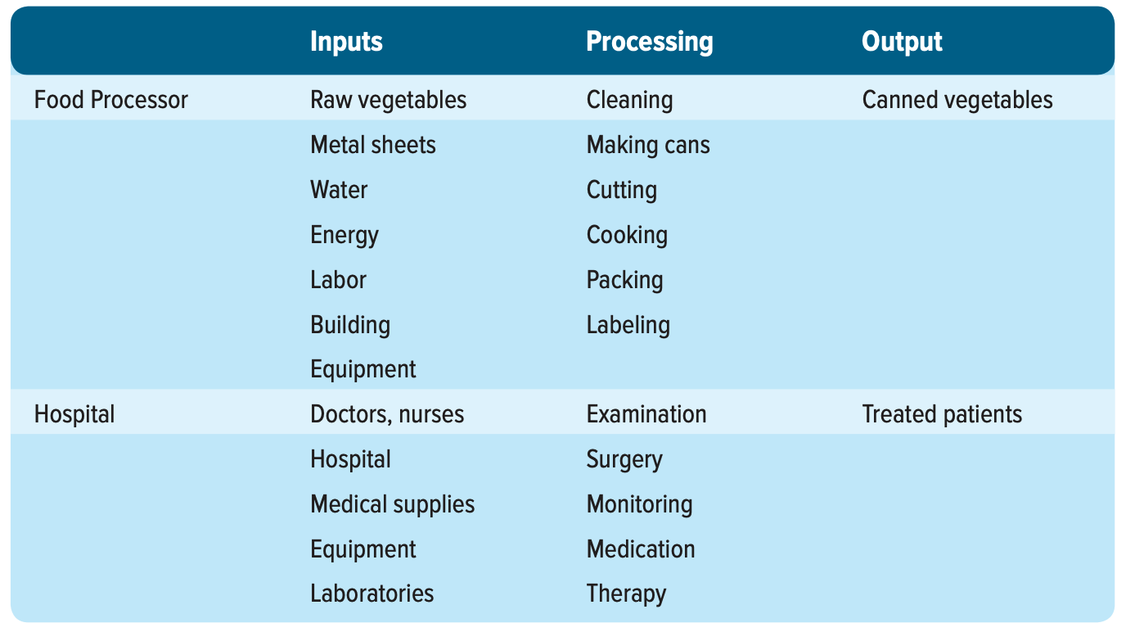
Illustrations of the transformation process
1-19

Slide 20
Transformation Process
Physical: as in manufacturing operations
Locational: as in transportation or warehouse operations
Exchange: as in retail operations
Physiological: as in health care
Psychological: as in entertainment
Informational: as in communication

Slide 21
Why Study Operations Management?
Every aspect of business affects or is affected by operations
Many service jobs are closely related to operations
Financial services
Marketing services
Accounting services
Information services
Through learning about operations and supply chains you will have a better understanding of:
The world you live in
The global dependencies of companies and nations
Reasons that companies succeed or fail
The importance of working with others
1-21

Slide 22
How is Operations Relevant to my Major?
Accounting - “As an auditor you must understand the fundamentals of operations management.”
Information Technology - “IT is a tool, and there’s no better place to apply it than in operations.”
Management - “We use so many things you learn in an operations class—scheduling, lean production, theory of constraints, and tons of quality tools.”
Economics - “It’s all about processes. I live by flowcharts and Pareto analysis.”
Marketing - “How can you do a good job marketing a product if you’re unsure of its quality or delivery status?”
Finance - “Most of our capital budgeting requests are from operations, and most of our cost savings, too.”

Slide 23
Basic Functions of the Business Organization
Organization
Marketing
Operations
Finance
Copyright ©2021 McGraw-Hill Education. All rights reserved. No reproduction or distribution without the prior written consent of McGraw-Hill Education.
1-23

Slide 24
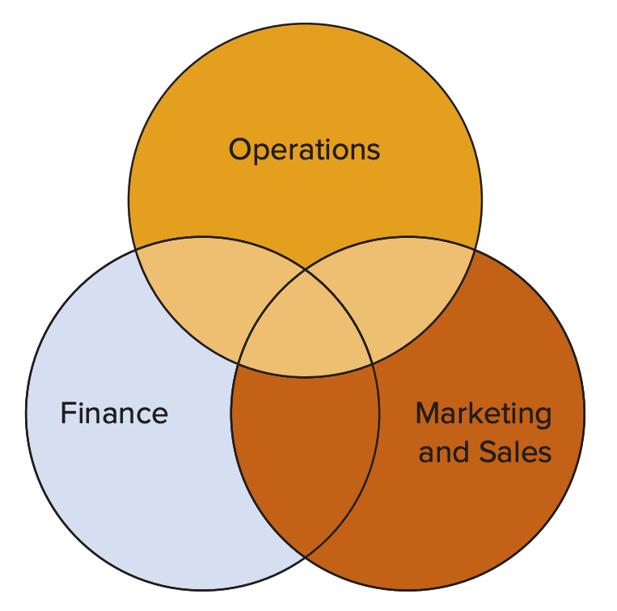
Function Overlap
Finance & operations
Budgeting
Economic analysis of investment proposals
Provision of funds
Marketing & operations
Demand data
Product and service design
Competitor analysis
Lead time data
1-24

Slide 25
Process Management
Process - one or more actions that transform inputs into outputs
Three Categories of Business Processes:
Upper-management processes | These govern the operation of the entire organization.
Operational processes | These are core processes that make up the value stream.
Supporting processes | These support the core processes.
Copyright ©2021 McGraw-Hill Education. All rights reserved. No reproduction or distribution without the prior written consent of McGraw-Hill Education.
1-25

Slide 26
Scope of Operations Management
The scope of operations management ranges across the organization.
The operations function includes many interrelated activities such as:
Forecasting
Capacity planning
Locating facilities
Facilities and layout
Scheduling
Managing inventories
Assuring quality
Motivating employees
And more . . .
Copyright ©2021 McGraw-Hill Education. All rights reserved. No reproduction or distribution without the prior written consent of McGraw-Hill Education.
1-26

Slide 27
Role of the Operations Manager
The Operations function consists of all activities directly related to producing goods or providing services.
A primary function of the operations manager is to guide the system by decision making.
System design decisions
System operation decisions
Copyright ©2021 McGraw-Hill Education. All rights reserved. No reproduction or distribution without the prior written consent of McGraw-Hill Education.
1-27

Slide 28
Systems Perspective
System - a set of interrelated parts that must work together
The business organization is a system composed of subsystems
Marketing subsystem
Operations subsystem
Finance subsystem
The systems perspective
Emphasizes interrelationships among subsystems
Main theme is that the whole is greater than the sum of its parts
The output and objectives of the organization take precedence over those of any one subsystem
Copyright ©2021 McGraw-Hill Education. All rights reserved. No reproduction or distribution without the prior written consent of McGraw-Hill Education.
1-28

Slide 29
System Design Decisions
System design
Capacity
Facility location
Facility layout
Product and service planning
Acquisition and placement of equipment
These are typically strategic decisions that
usually require long-term commitment of resources
determine parameters of system operation
Copyright ©2021 McGraw-Hill Education. All rights reserved. No reproduction or distribution without the prior written consent of McGraw-Hill Education.
1-29

Slide 30
System Operation Decisions
System operation
These are generally tactical and operational decisions
Management of personnel
Inventory management and control
Scheduling
Project management
Quality assurance
Operations managers spend more time on system operation decision than any other decision area
They still have a vital stake in system design
Copyright ©2021 McGraw-Hill Education. All rights reserved. No reproduction or distribution without the prior written consent of McGraw-Hill Education.
1-30

Slide 31
OM Decision Making
Most operations decisions involve many alternatives that can have quite different impacts on costs or profits
Typical operations decisions include:
What: What resources are needed, and in what amounts?
When: When will each resource be needed? When should the work be scheduled? When should materials and other supplies be ordered?
Where: Where will the work be done?
How: How will the product or service be designed? How will the work be done? How will resources be allocated?
Who: Who will do the work?
Copyright ©2021 McGraw-Hill Education. All rights reserved. No reproduction or distribution without the prior written consent of McGraw-Hill Education.
1-31

Slide 32
General Approach to Decision Making
Modeling is a key tool used by all decision makers
Model - an abstraction of reality; a simplification of something
Common features of models:
They are simplifications of real-life phenomena
They omit unimportant details of the real-life systems they mimic so that attention can be focused on the most important aspects of the real-life system
Physical Model – miniature airplane
Schematic Model – drawing of a city
Mathematical Model – Inventory optimization
Copyright ©2021 McGraw-Hill Education. All rights reserved. No reproduction or distribution without the prior written consent of McGraw-Hill Education.
1-32

Slide 33
Quantitative and Qualitative Approaches to Decision Making
Quantitative DM is a decision-making approach that frequently seeks to obtain a mathematically optimal solution
Supported by computer calculations
Often work together with qualitative approaches
Importance of performance measurements to decision making
Note the metrics being used in various areas of operation and how they are applied to manage operations and decision making.
1-33

Slide 34
Performance Metrics and Trade-Offs
Performance metrics
All managers use metrics to manage and control operations
Profits
Costs
Quality
Productivity
Flexibility
Inventories
Schedules
Forecast accuracy
Analysis of trade-offs
A trade-off is giving up one thing in return for something else
Carrying more inventory (an expense) in order to achieve a greater level of customer service
Copyright ©2021 McGraw-Hill Education. All rights reserved. No reproduction or distribution without the prior written consent of McGraw-Hill Education.
1-34

Slide 35
Establishing Priorities
In nearly all cases, certain issues or items are more important than others
Recognizing this allows managers to focus their attention to those efforts that will do the most good
Pareto Phenomenon - a few factors account for a high percentage of occurrence of some event(s)
The critical few factors should receive the highest priority
This is a concept that is appropriately applied to all areas and levels of management
Copyright ©2021 McGraw-Hill Education. All rights reserved. No reproduction or distribution without the prior written consent of McGraw-Hill Education.
1-35

Slide 36
Historical Evolution of OM
Industrial Revolution
Began in England is the 1770s, division of labor (Adam Smith)
Scientific management
Based on observation, measurement, analysis and improvement of work methods; management is responsible for planning etc.
Human relations movement
Emphasized the importance of the human element in job design
Decision models and management science
Application of mathematical methods/models for inventory management, quality control, operational research, linear programming
Influence of Japanese manufacturers
Refined and developed management practices that increased productivity (e.g. Just-in-time production)
Copyright ©2021 McGraw-Hill Education. All rights reserved. No reproduction or distribution without the prior written consent of McGraw-Hill Education.
1-36

Slide 37
Operations Today
Technology Management
Global competition
Working with fewer resources
Revenue management
Agility
Copyright ©2021 McGraw-Hill Education. All rights reserved. No reproduction or distribution without the prior written consent of McGraw-Hill Education.
1-37

Slide 38
Key Issues for Operations Managers Today
Economic conditions
Innovating
Quality problems
Risk management
Cyber-security
Competing in a global economy
Copyright ©2021 McGraw-Hill Education. All rights reserved. No reproduction or distribution without the prior written consent of McGraw-Hill Education.
1-38

Slide 39
Environmental Concerns
Sustainability
Using resources in ways that do not harm ecological systems that support human existence
Sustainability measures often go beyond traditional environmental and economic measures to include measures that incorporate social criteria in decision making
All areas of business will be affected
Product and service design
Consumer education programs
Disaster preparation and response
Supply chain waste management
Outsourcing decisions
Copyright ©2021 McGraw-Hill Education. All rights reserved. No reproduction or distribution without the prior written consent of McGraw-Hill Education.
1-39

Slide 40
Ethical Issues in Operations
Ethical issues that may arise in many aspects of operations management:
Financial statements
Worker safety
Product safety
Quality
The environment
The community
Hiring and firing workers
Closing facilities
Workers’ rights
Copyright ©2021 McGraw-Hill Education. All rights reserved. No reproduction or distribution without the prior written consent of McGraw-Hill Education.
1-40

Slide 41
The Need for Supply Chain Management
In the past, organizations did little to manage the supply chain beyond their own operations and immediate suppliers which led to numerous problems
Oscillating inventory levels
Inventory stockouts
Late deliveries
Quality problems
Copyright ©2021 McGraw-Hill Education. All rights reserved. No reproduction or distribution without the prior written consent of McGraw-Hill Education.
1-41

Slide 42
Supply Chain Issues
The need to improve operations
Increasing levels of outsourcing
Increasing transportation costs
Competitive pressures
Increasing globalization
Increasing importance of e-business
The complexity of supply chains
The need to manage inventories
Copyright ©2021 McGraw-Hill Education. All rights reserved. No reproduction or distribution without the prior written consent of McGraw-Hill Education.
1-42

Slide 43
References & more information
Stevenson (2021), Chapter 1
Russell et al. (2017), Chapter 1

Slide 44
Next Week Quality Management

